Slide 1

Predicting Political Party Affiliation in North Carolina
AMS 325 Final Project
Adam Amer • Sean O’Grady • William Leung

Slide 2

Goals
Use North Carolina’s publicly-available voter records to predict voter affiliation via machine learning
We are using records from Alamance County
Determine the best machine learning model for predicting voter affiliation

Slide 3
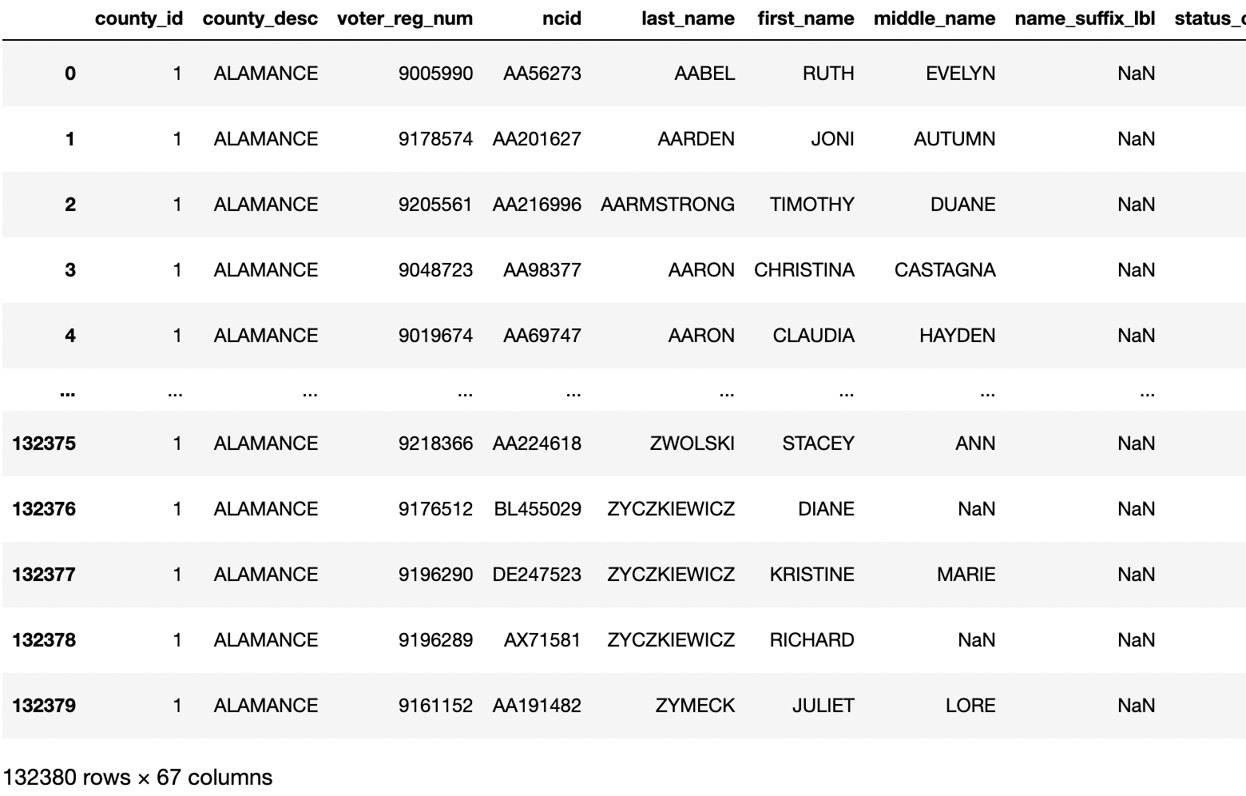
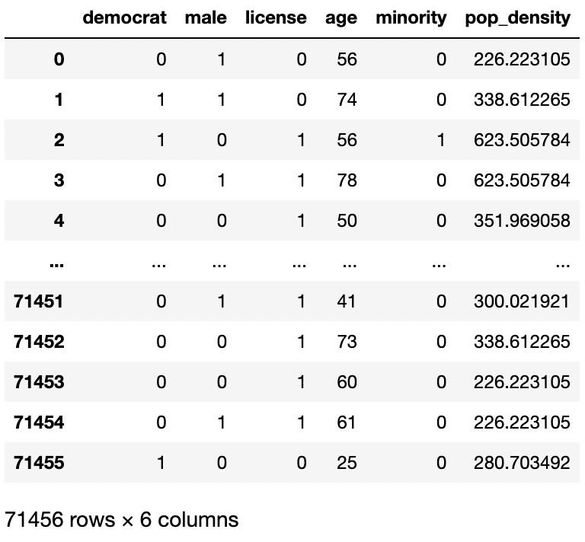
Dataset
Imported Excel datasheet to Python using Pandas
Clean Data: Remove rows with “bad” data
Old: 132380 people, 67 variables
New: 71456 people, 6 variables

Slide 4
Input Variables
Input Variables:
Age
Gender (Binary Variable)
Minority Status (Binary Variable)
Driver’s License (Binary Variable)
Population Density (Using a dictionary to find density from zip code)
Examples of excluded variables:
Address, Phone Number, Birthstate (Irrelevant)
School District, Fire District, Sanitary District (Too Little Data)
Note: The district related variables could be collinear with each other
Source: https://www.ncsbe.gov/results-data/voter-registration-data

Slide 5
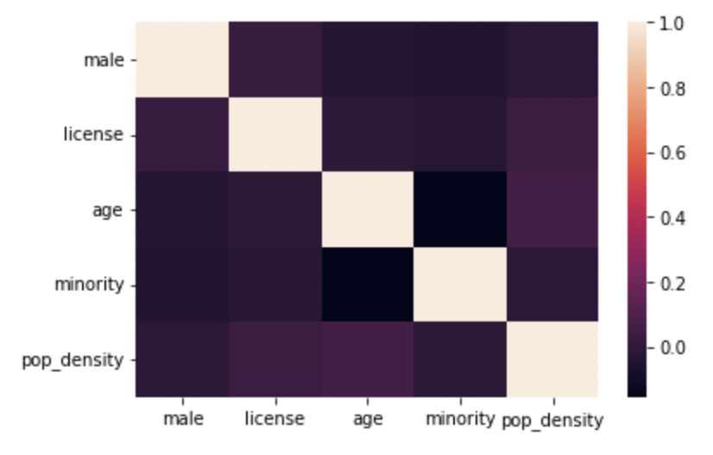
Correlation Between Selected Input Variables
None of the variables are highly correlated with one another
High correlation between variables may lead to multicollinearity

Slide 6
Output Variables
Output Variables:
Democrat/Republican (Binary Variable)
Special Circumstance:
Liberaterian
Libertarians will be combined with Republicans
Binary Variable would be preferred so combination is necessary
Libertarians core beliefs are similar to Republican core beliefs
Excluded:
Unaffiliated (May Clutter Data Analysis)
Source: https://www.ncsbe.gov/results-data/voter-registration-data

Slide 7
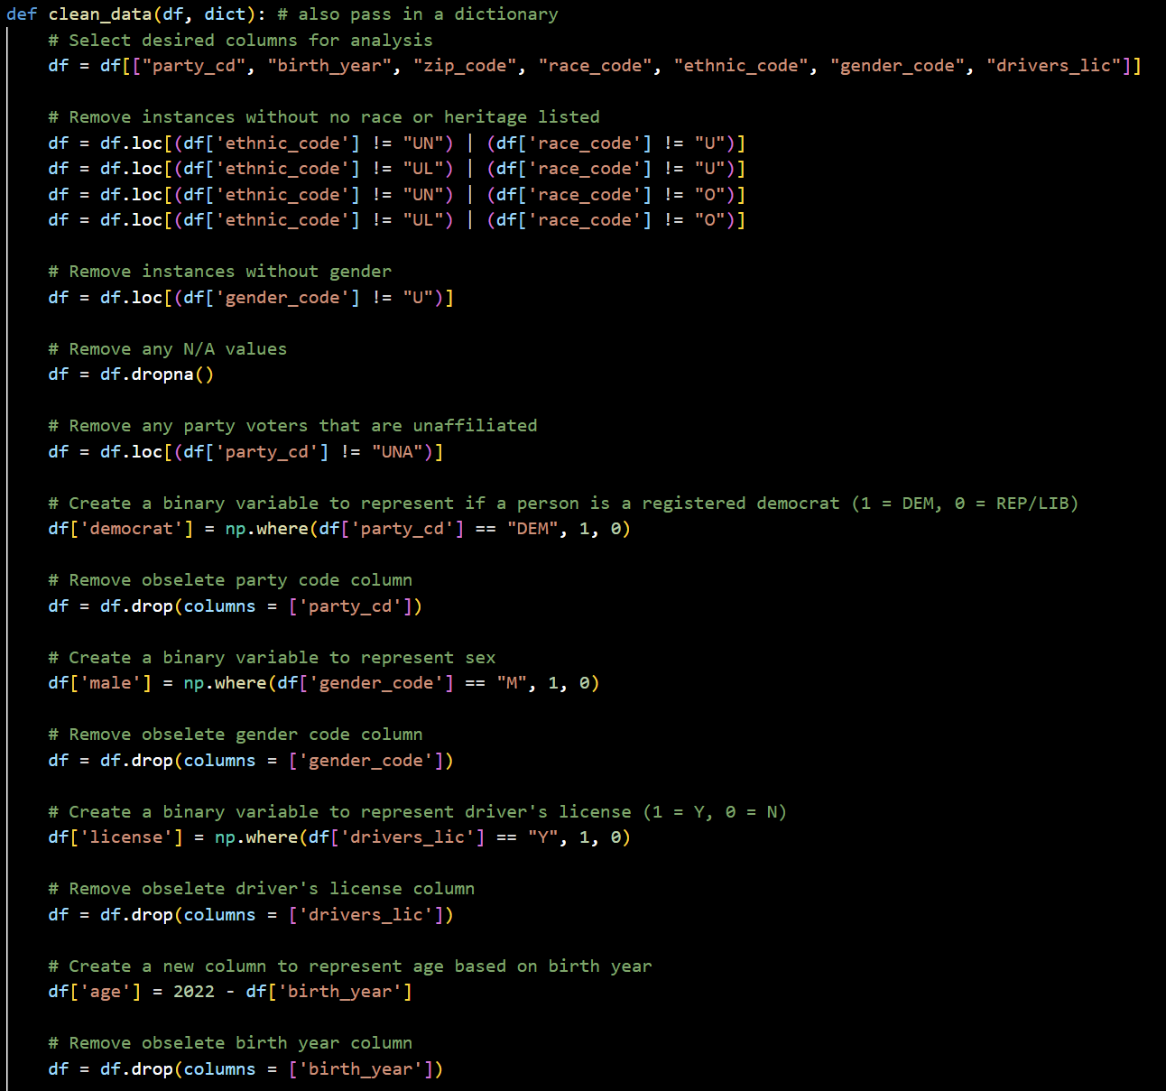
Data Cleaning Methodology
Selected columns
Party, birth year, zip code, race code, ethnic code, gender code, driver’s license status
Removed all instances with no race or heritage listed
Removed all instances with no gender listed
Removed any instances with missing data in the listed columns
Created binary variable for minority status based on race code and ethnic code
0 if they are white and not hispanic, 1 otherwise
Changed birth year into age
Discussion on zip code on the next slide

Slide 8
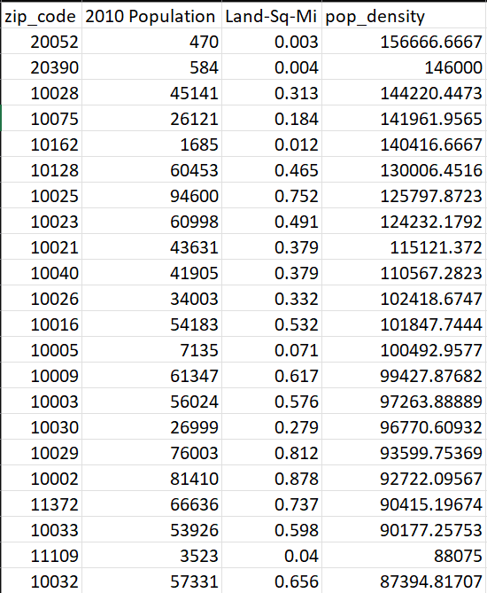
Data Cleaning Methodology
In order to utilize the zip code data, we brought in another dataset from here
This contains a list of every zip code in the US and their respective population density
We created a dictionary between zip codes and their densities, then mapped these densities onto the dataframe based on the zip code

Slide 9
Further Data Preparation
Scale age and population density variables from 0 to 1
K-nearest neighbors and Support Vector Machine are distance based
Features with small data values may become uninformative when calculating euclidean distance if large data values are present
Split the data into training and testing sets
80% used for training
20% used for testing
Looking for accuracy scores for the machine learning algorithms
This is the proportion of correctly predicted party affiliation on the testing set

Slide 10
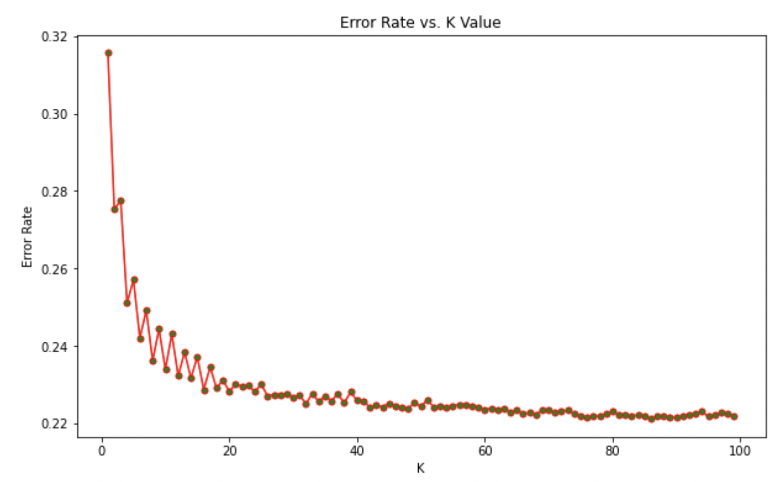
K-Nearest Neighbors
K-nearest neighbors to help divide the data into testing and training sets
A k-value of 39 is chosen as it is where the graph starts to diverge
An odd number to break ties to definitively classify data into sets
K-Nearest Neighbors Accuracy Score: 0.7736495941785614

Slide 11
Support Vector Machine + Logistic Regression
Support Vector Machine Accuracy Score: 0.7734396865379233
Logistic Regression Accuracy Score: 0.7730198712566471
Given the results, it seems that each model has a similar level of accuracy
Different random seeds may differ the accuracy of each model
K-nearest neighbors is the model with the highest accuracy (0.7736495941785614)
It seems that we are able to fairly accurately predict party affiliation!

Slide 12
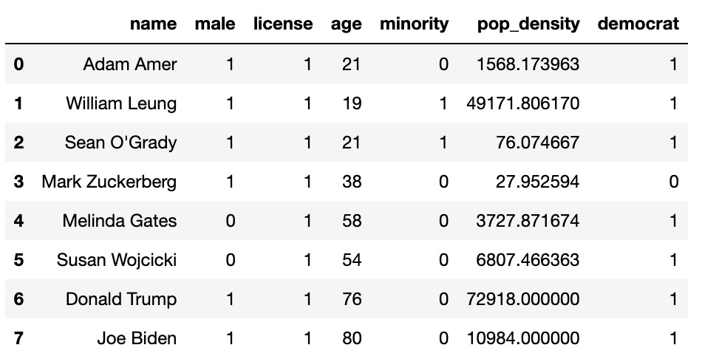
Testing Machine Learning
Test ourselves and celebrities by inputting demographic information
Keep in mind that the trained data is only on Alamance, NC
Population density and minority status may affect inputted data the most due to Alamance’s demographics

Slide 13
Further Questions
Outside of Alamance
How does predicting data from Alamance, NC affect predicting individuals from other places?
Libertarian vs. Republican
Will there be a disproportionate amount of predicted data listed as libertarian if we included it as an additional output variable?
Variable Correlation
What variables are most highly correlated with predicting voter affiliation?

